Slide 1
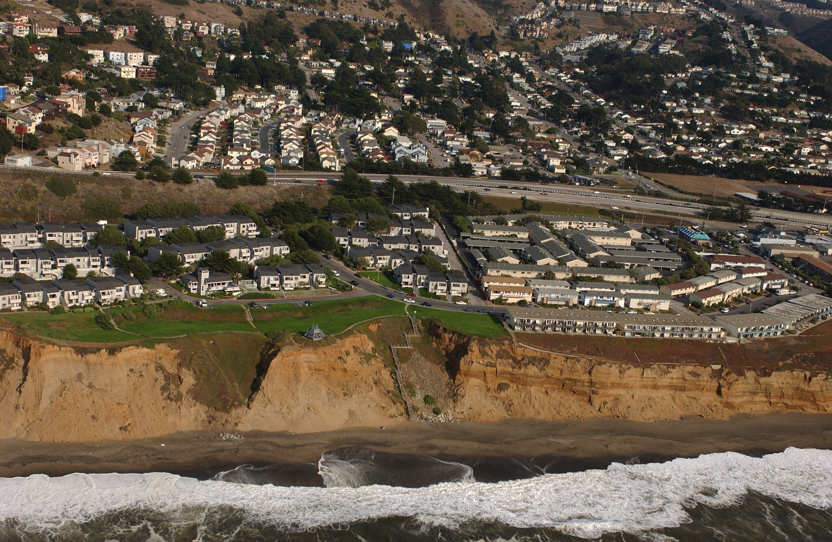
2002-2013, Pacifica, CA
Notes:
Copyright (C) 2002-2014 Kenneth & Gabrielle Adelman, California Coastal Records Project, www.californiacoastline.org

Slide 2
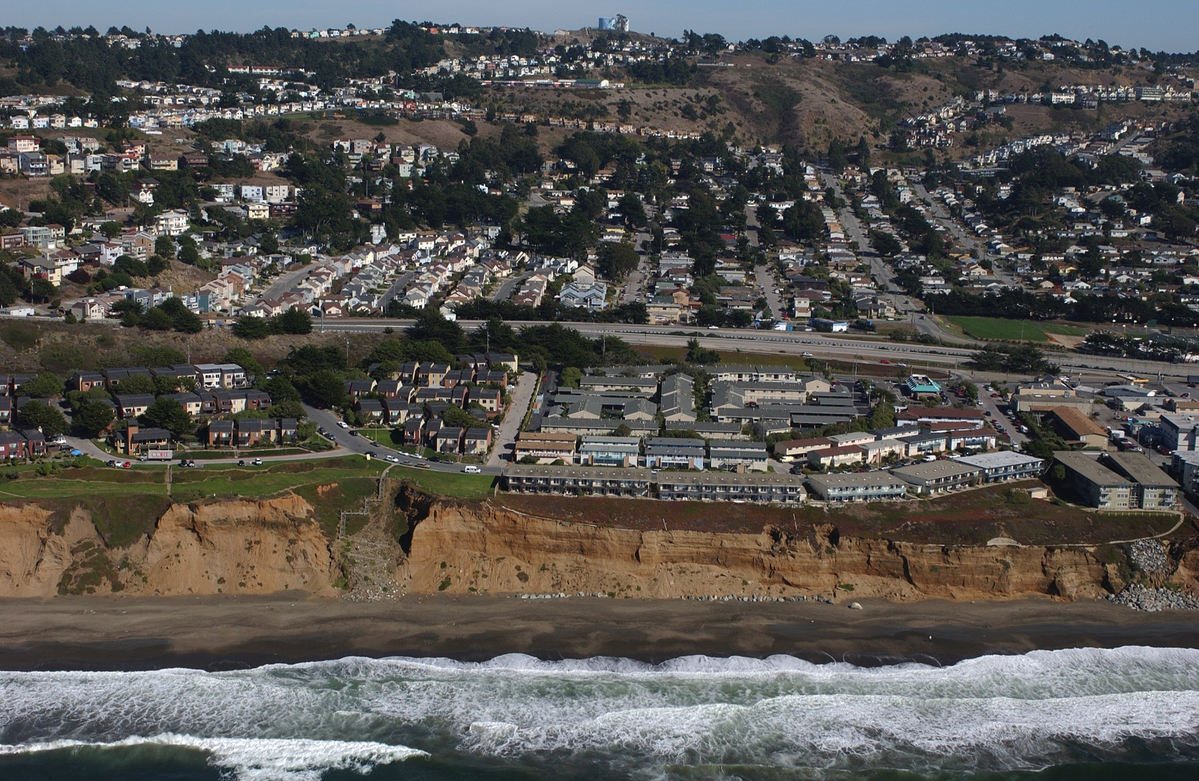
Notes:
Copyright (C) 2002-2014 Kenneth & Gabrielle Adelman, California Coastal Records Project, www.californiacoastline.org

Slide 3
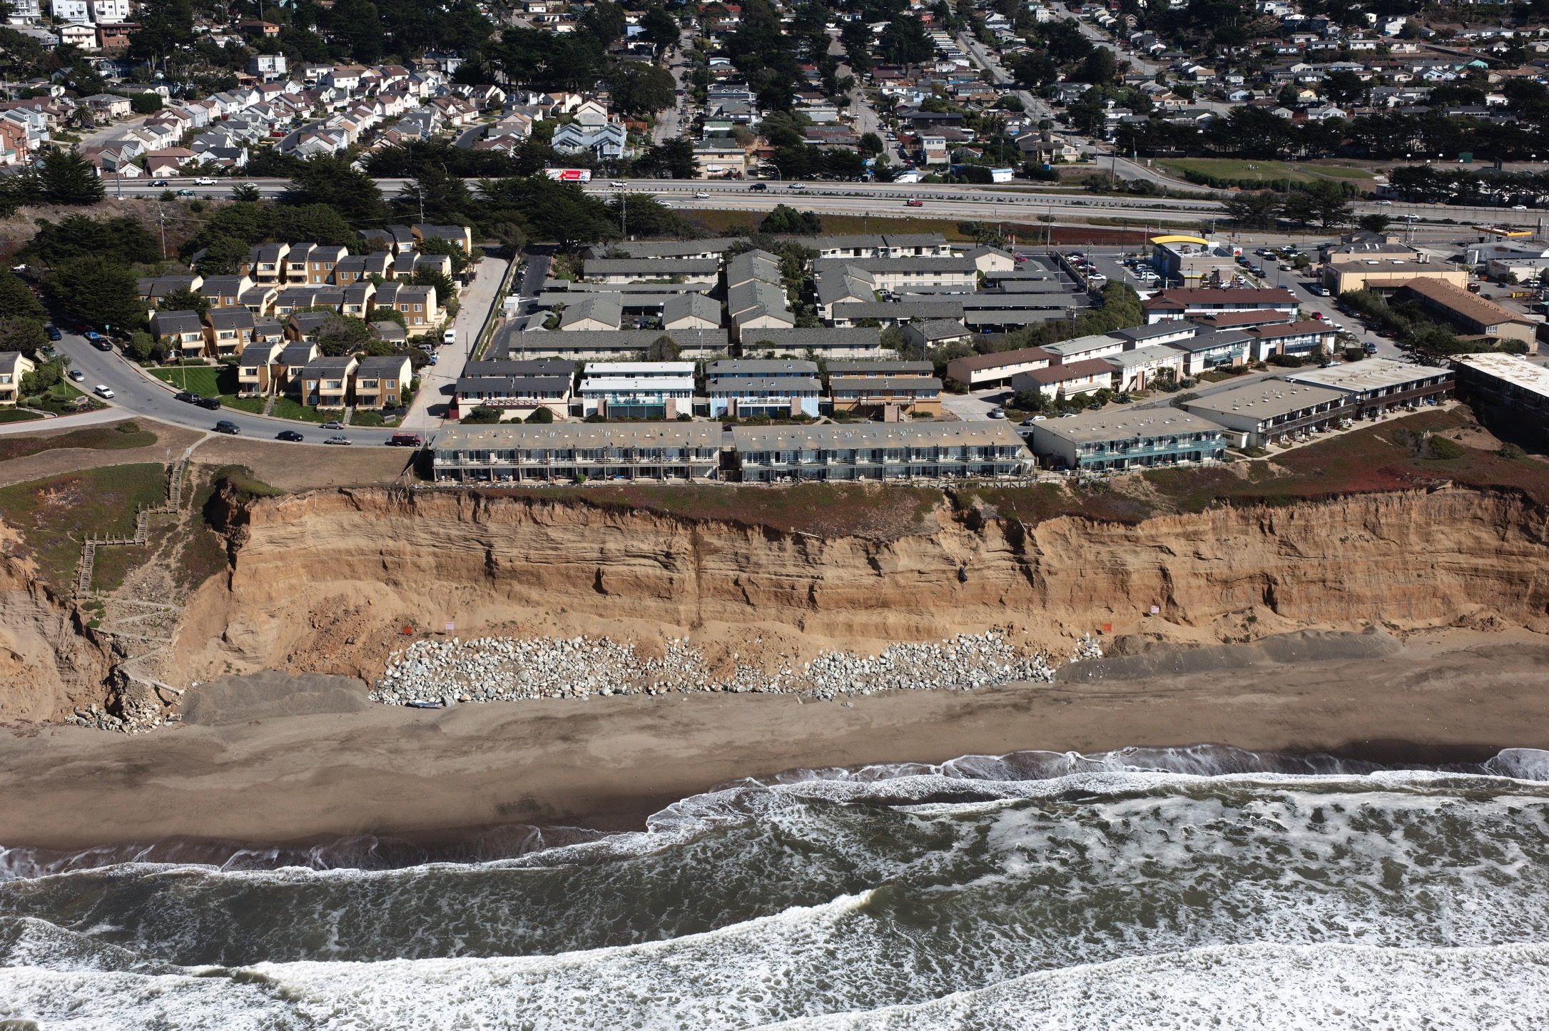
Notes:
Copyright (C) 2002-2014 Kenneth & Gabrielle Adelman, California Coastal Records Project, www.californiacoastline.org

Slide 4
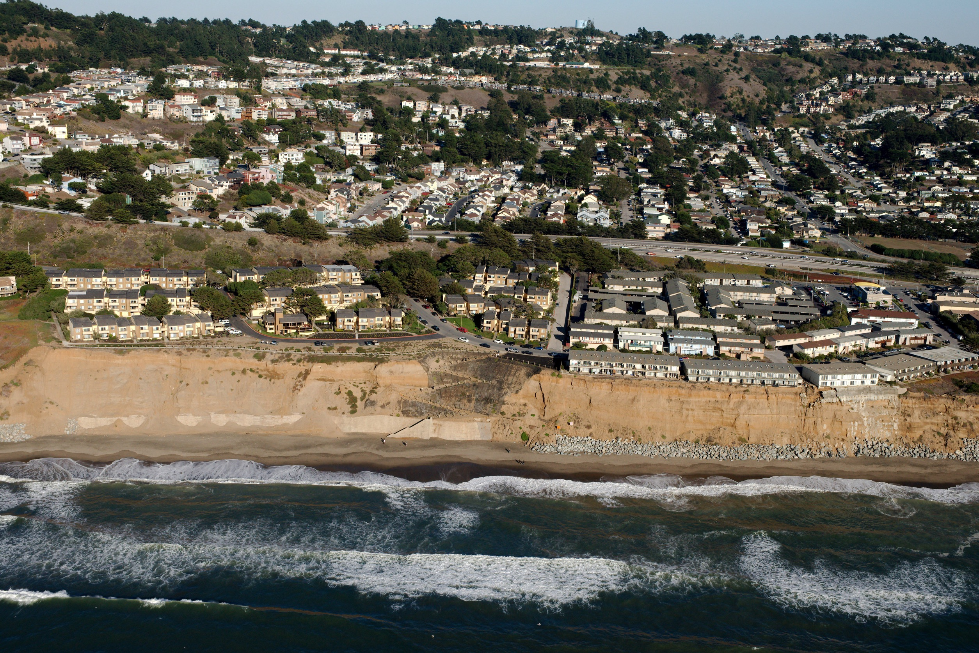
Notes:
Copyright (C) 2002-2014 Kenneth & Gabrielle Adelman, California Coastal Records Project, www.californiacoastline.org

