Slide 1
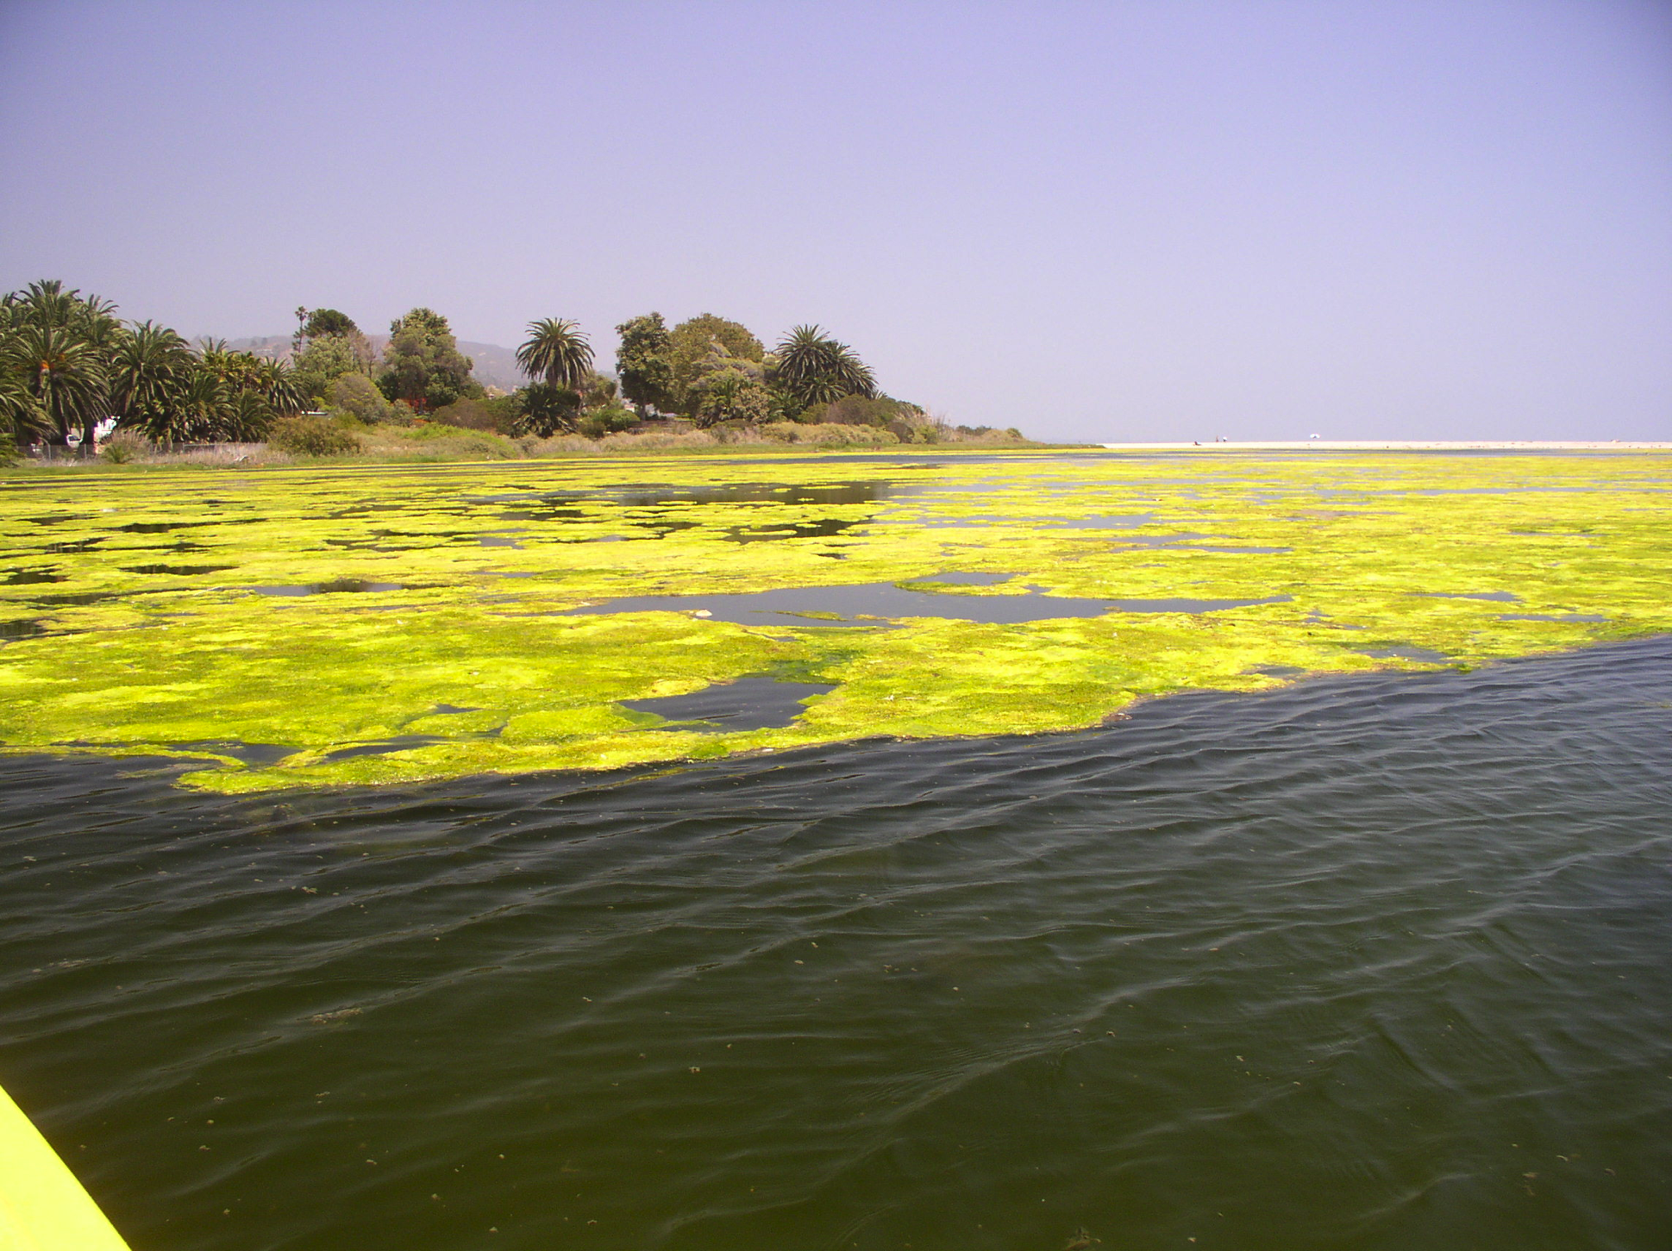
Notes:
This is “Malibu Muck,” (eutrophication) the result of leaking septic tanks, poor water circulation, and nutrient enrichment. Sharp eyes will note the complete absence of birdlife in the large shot, a normal situation before restoration.
All photos: Kurt Holland

Slide 2
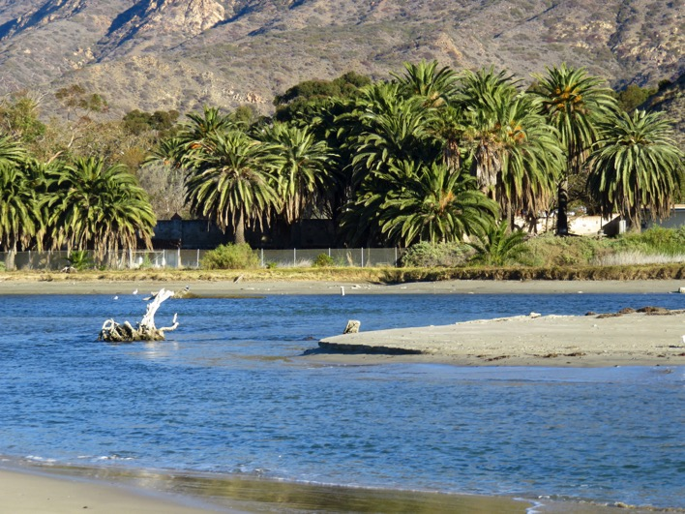
Notes:
This photo is Malibu Lagoon after coastal ecologists restored for ecological functioning. The birdlife in the next slide were all observed on a short morning walk along the shore formerly plagued by Malibu Muck.

Slide 3
