Slide 1
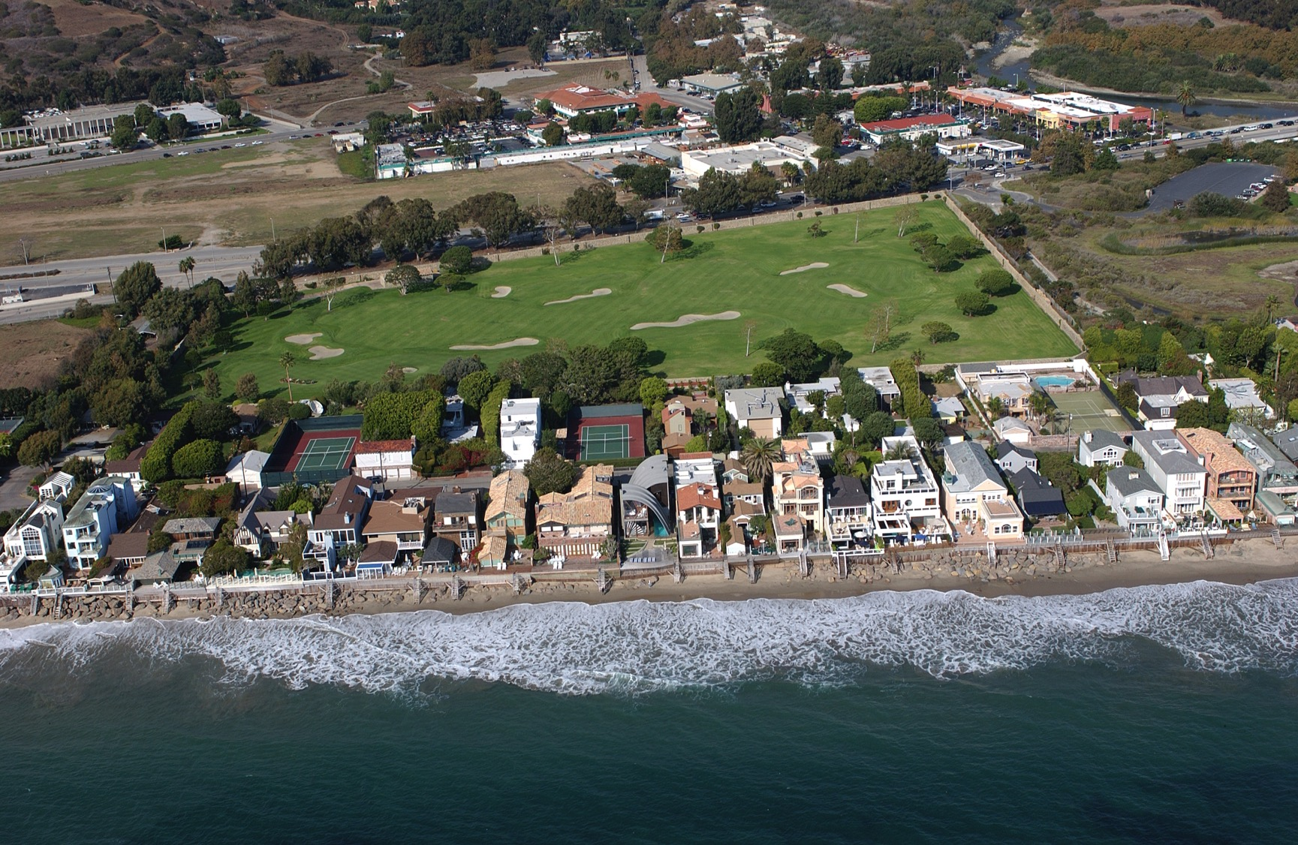
Notes:
Malibu Colony “How does the built landscape in the image provide evidence of the legal and policy environment in force when this place was developed”
Copyright (C) 2002-2014 Kenneth & Gabrielle Adelman, California Coastal Records Project, www.californiacoastline.org

