Slide 1
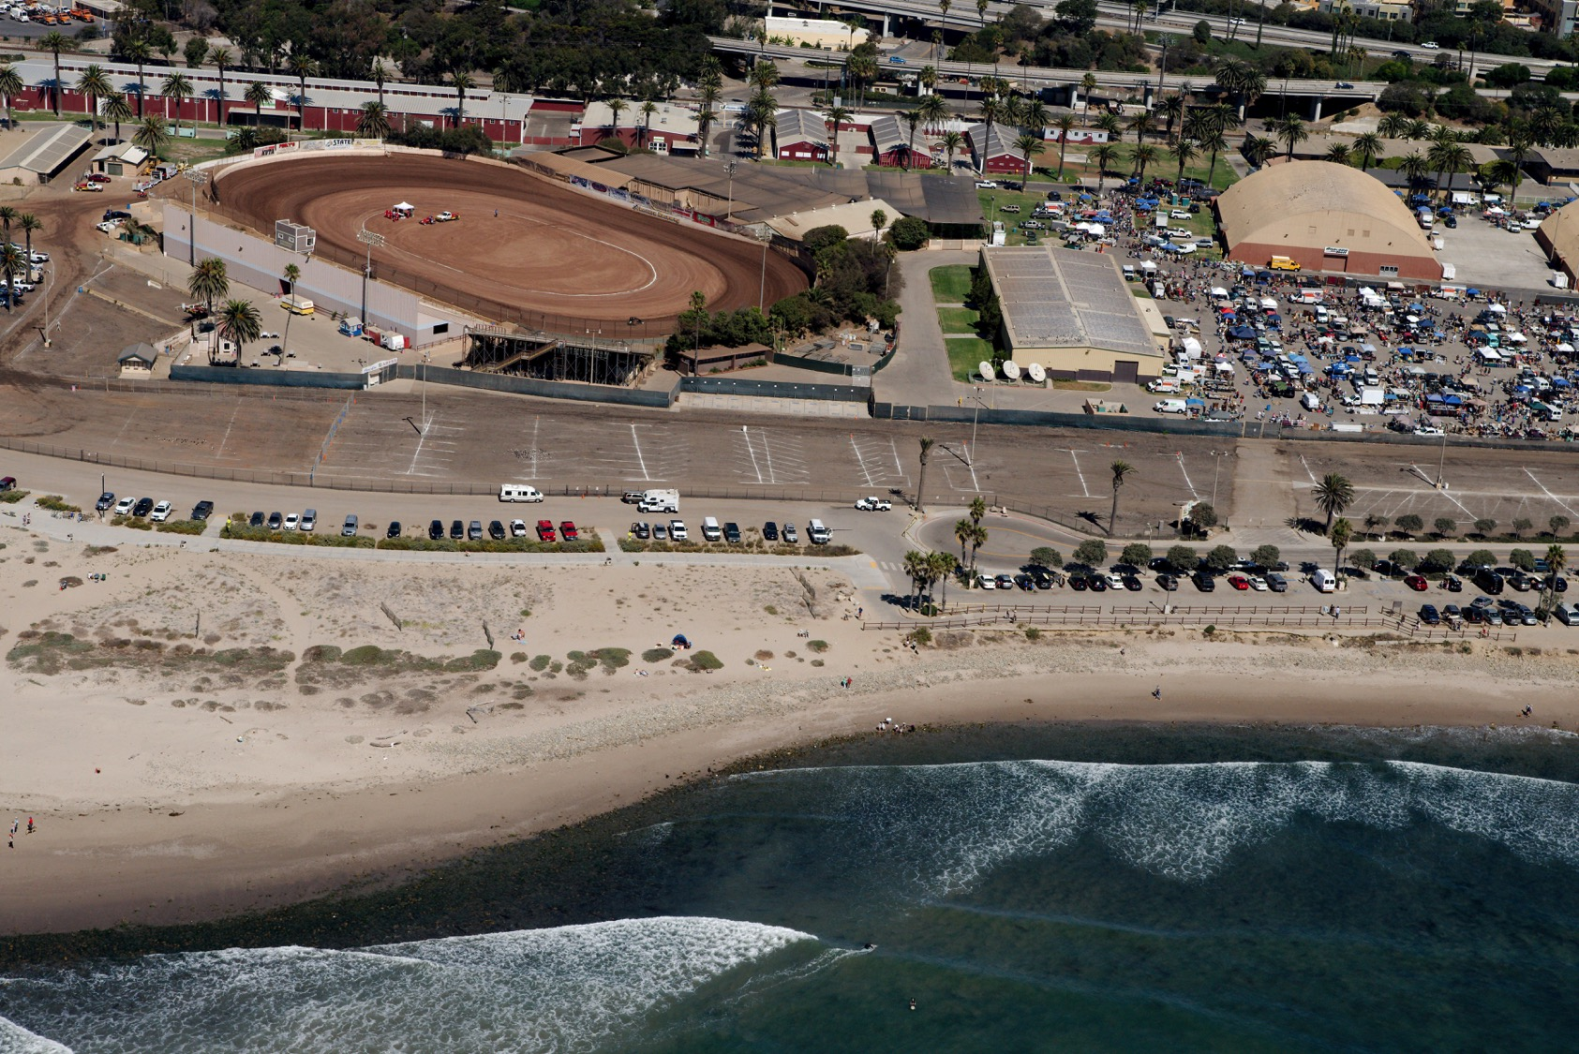
Notes:
Surfers Point Managed Retreat Comparison
Copyright (C) 2002-2014 Kenneth & Gabrielle Adelman, California Coastal Records Project, www.californiacoastline.org

Slide 2
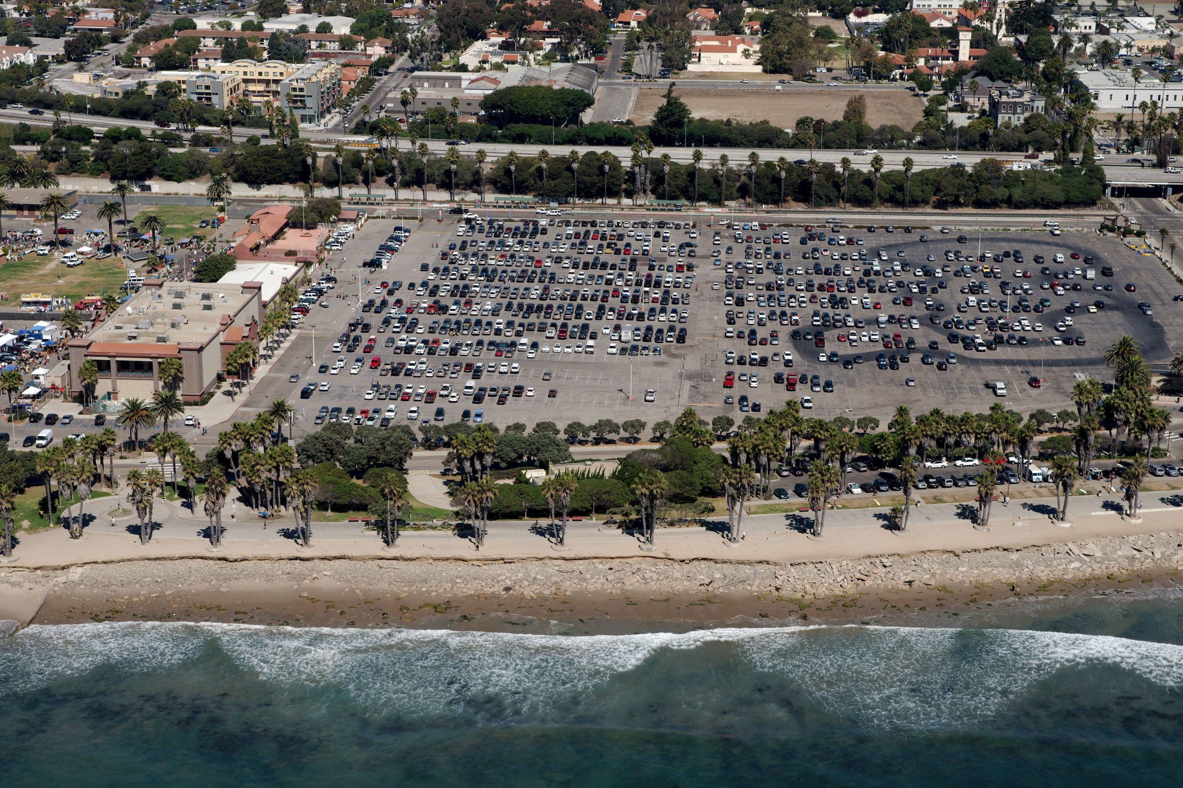
Notes:
2. Wave Attack Next to Managed Retreat Site. Being armored 01/16
Copyright (C) 2002-2014 Kenneth & Gabrielle Adelman, California Coastal Records Project, www.californiacoastline.org

