Slide 1
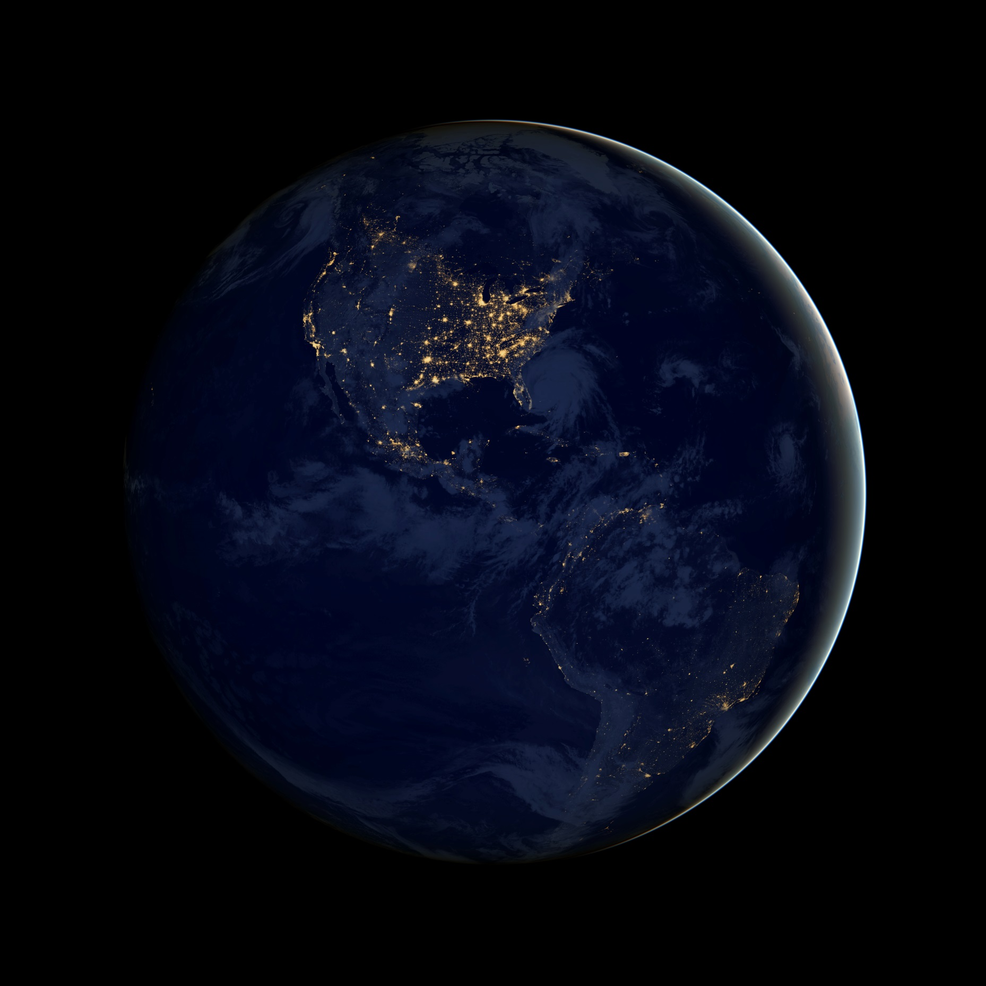
Notes:
The Dark Marble (Night Version of Blue Marble from 1.1). Image NASA

Slide 2
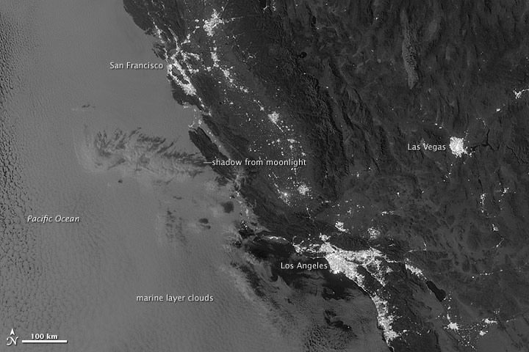
Notes:
Night time shot of California, NASA

