Slide 1
Carmel Beaches
Beach Color Comparison
Activity Guiding Question:
What natural processes are responsible for the difference in observed color?
The geological parent materials are both granitic.

Slide 2
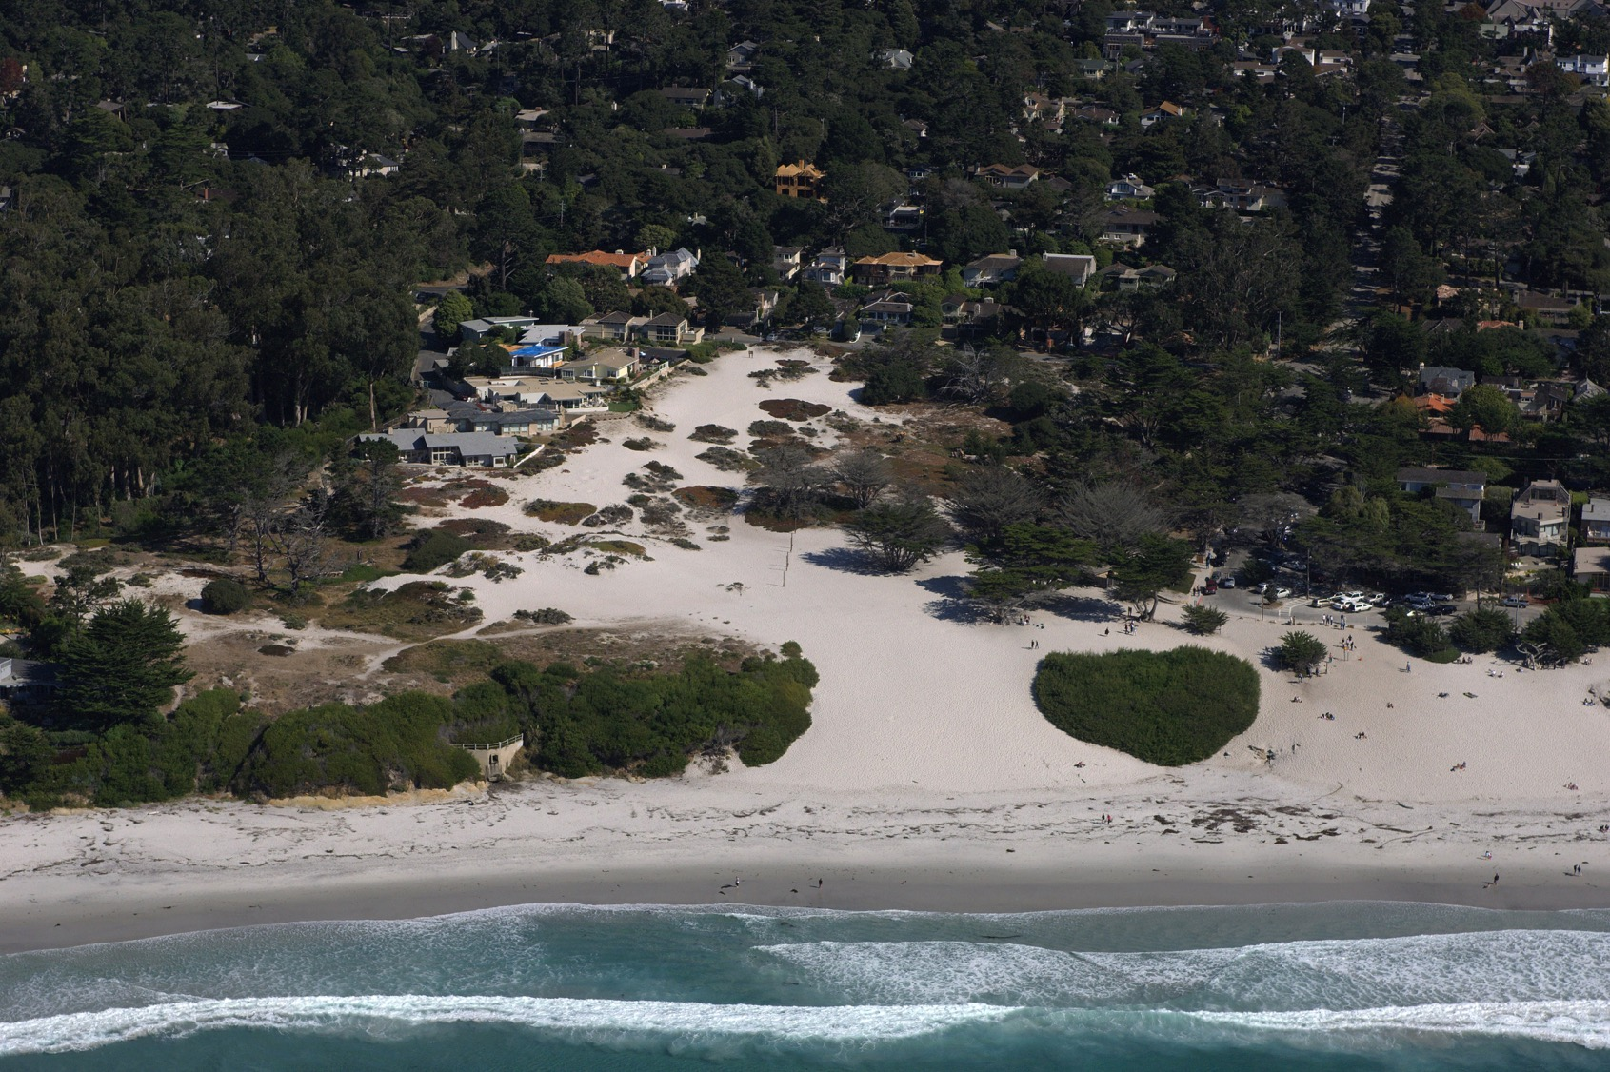
Notes:
Carmel City Beach. The parent material for this beach is Santa Lucia granodiorite, with few biogenic inputs.
Copyright (C) 2002-2014 Kenneth & Gabrielle Adelman, California Coastal Records Project, www.californiacoastline.org

Slide 3
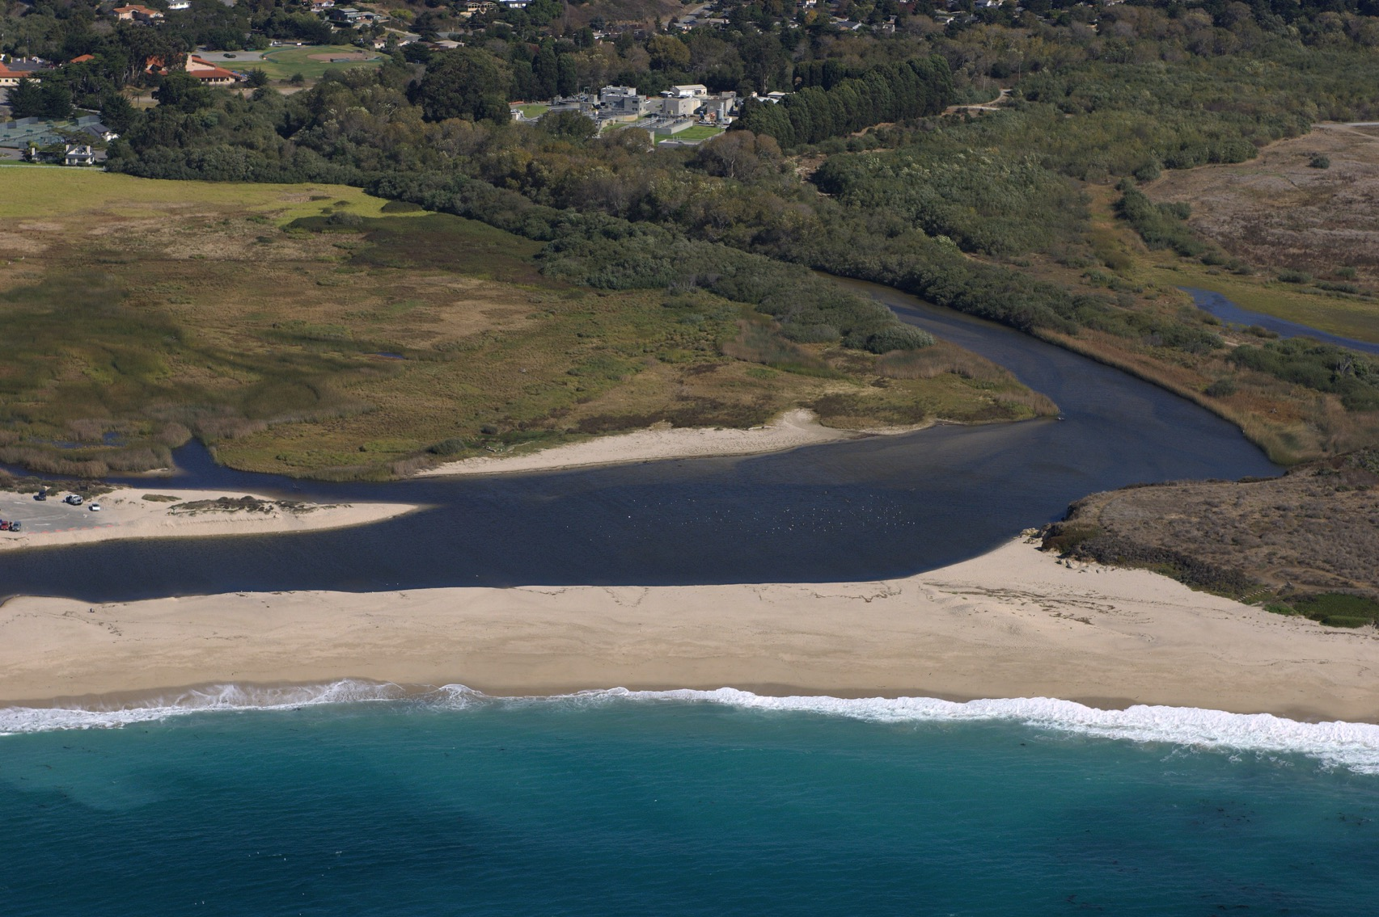
Notes:
Carmel River Beach, with Carmel City Beach inset. The color distinction is due to the large amount of biogenic material being deposited in this beach system by Carmel River. Nearby Carmel City Beach to the north is a relatively closed system due to the headland between the two beaches, and receives almost no river discharge under normal circumstances.
Copyright (C) 2002-2014 Kenneth & Gabrielle Adelman, California Coastal Records Project, www.californiacoastline.org

Slide 4


