Slide 1
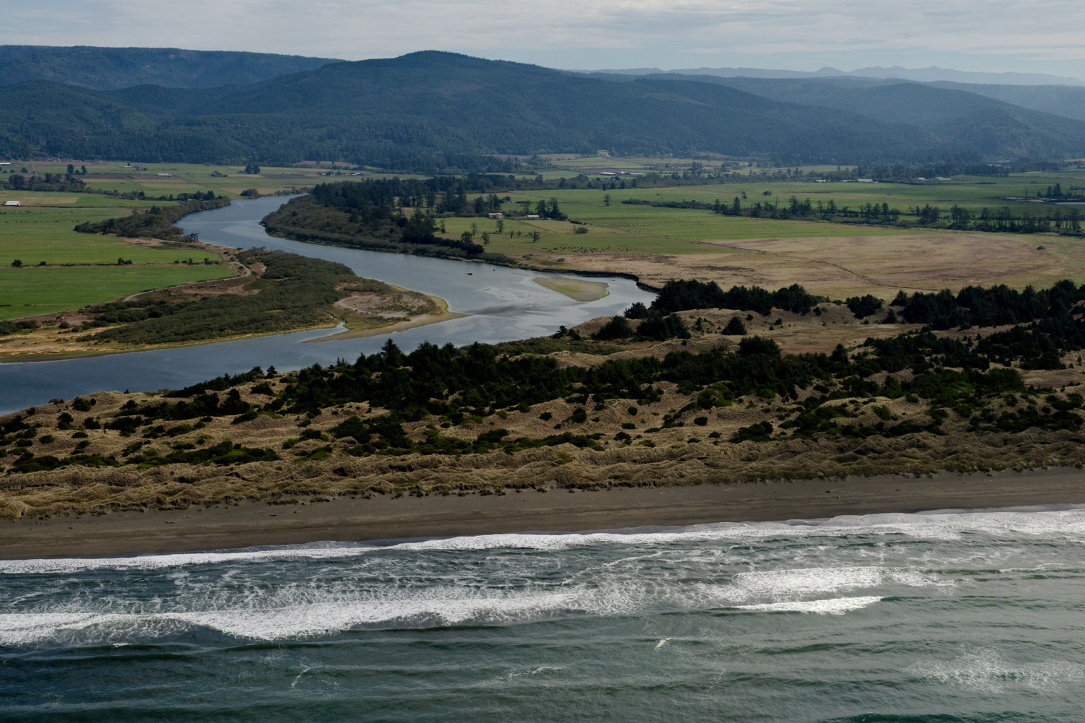
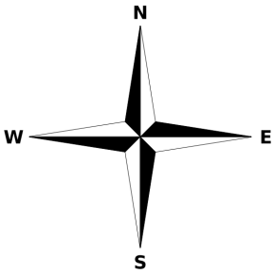
Notes:
Tolowa Dunes, Del Norte County. Inset satellite view of the location. Copyright (C) 2002-2014 Kenneth & Gabrielle Adelman, California Coastal Records Project, www.Californiacoastline.org and Google 2016

